Slide 1
CPU软渲染 路径追踪渲染器
多重重要性采样 B站：HeaoYe

Slide 2
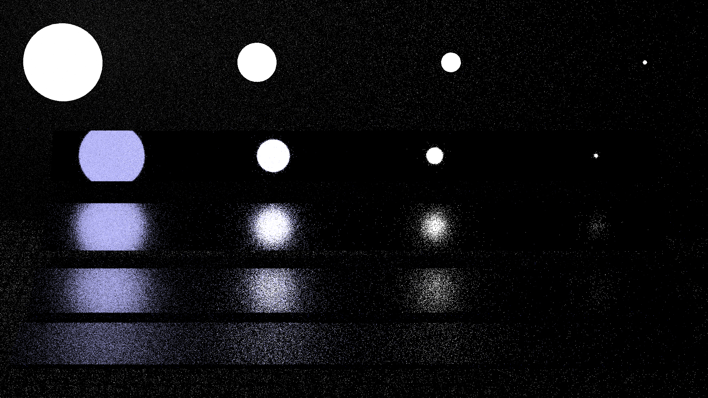
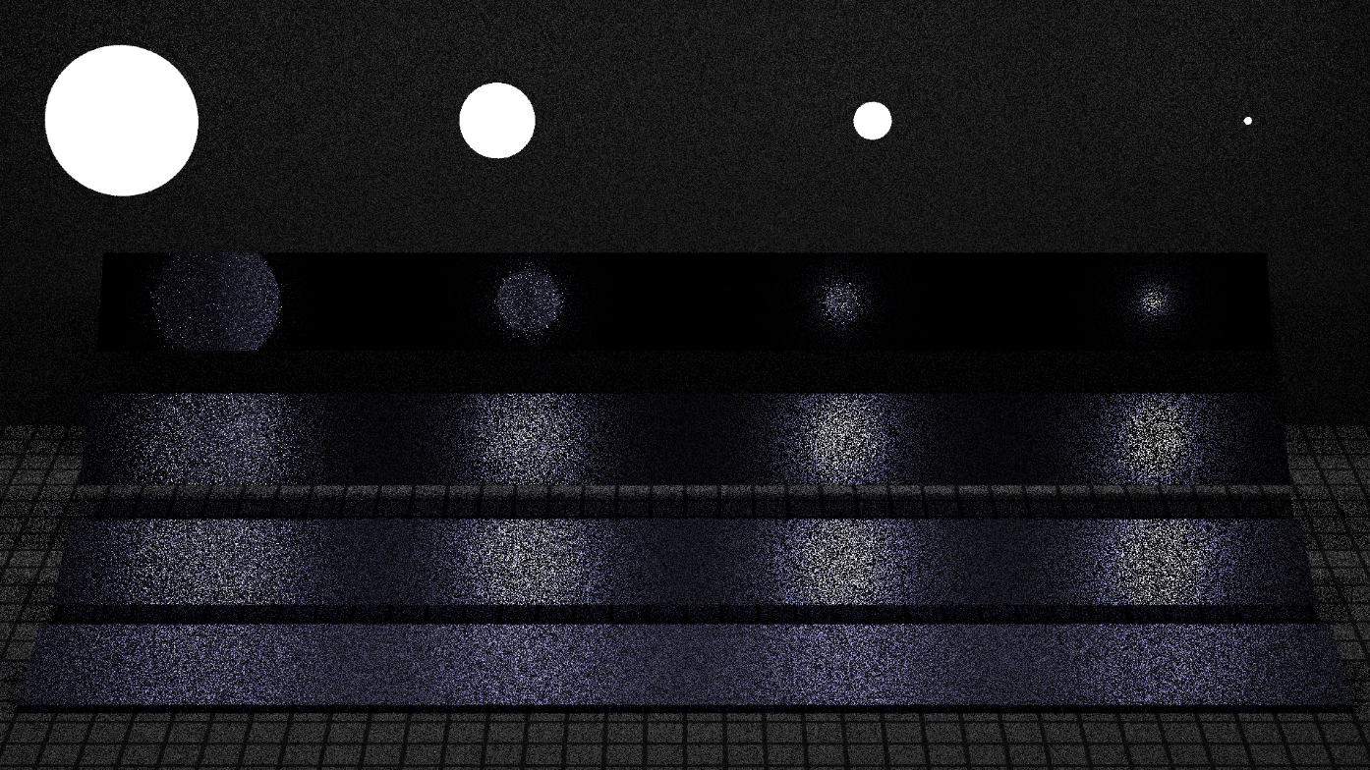
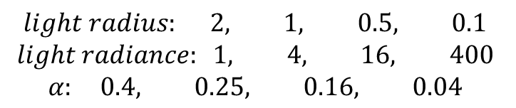
目前渲染的问题
Sample BSDF 4spp
Sample Light 4spp
$$light radius: 2, 1, 0.5, 0.1$$
$$light radiance: 1, 4, 16, 400$$
$$α: 0.4, 0.25, 0.16, 0.04$$

Slide 3

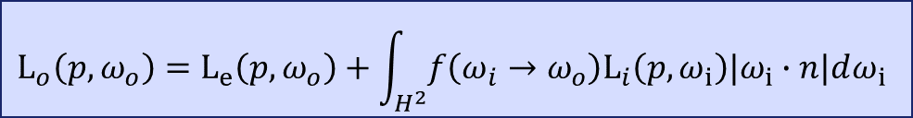

蒙特卡洛积分器 Monte Carlo Integration
$$\int_{D}^{ }{f\left(x\right)dx}=？ F_{N}=\frac{1}{N}\sum_{i=1}^{N}{\frac{f(X_{i})}{p(X_{i})}}$$
$随机变量X_{i}服从\text{概率密度} \text{p}\text{(}\text{x}\text{)}$，且x∈D
$$\text{E}\left(F_{N}\right)=E\left(\frac{1}{N}\sum_{i=1}^{N}{\frac{f\left(X_{i}\right)}{p\left(X_{i}\right)}}\right)$$
$$=\frac{1}{N}E\left(\sum_{i=1}^{N}{\frac{f\left(X_{i}\right)}{p\left(X_{i}\right)}}\right)$$
$$=\frac{1}{N}\sum_{i=1}^{N}{E\left(\frac{f\left(X_{i}\right)}{p\left(X_{i}\right)}\right)}$$
$$=\int_{D}^{ }{\frac{f\left(x\right)}{p\left(x\right)}p\left(x\right)dx}$$
$$=\int_{D}^{ }{f\left(x\right)dx}$$
$$L_{o}\left({p,ω}_{o}\right)=L_{e}\left(p,ω_{o}\right)+\int_{H^{2}}^{ }{f\left(ω_{i}→ω_{o}\right)L_{i}\left(p,ω_{i}\right)|ω_{i}∙n|dω_{i}}$$
$$根据p\left(ω\right)采样N个\text{入射方向}$$
$$记为： ω_{ik} k=1,2,3,……,N$$
$$\int_{H^{2}}^{ }{f\left(ω_{i}→ω_{o}\right)L_{i}\left(p,ω_{i}\right)|ω_{i}∙n|dω_{i}}$$
$$\frac{1}{N}\sum_{k=i}^{N}{\frac{f\left(ω_{ik}→ω_{o}\right)L_{i}\left(p,ω_{ik}\right)|ω_{ik}∙n|}{p\left(ω_{i}\right)}}$$
N = 1

Slide 4
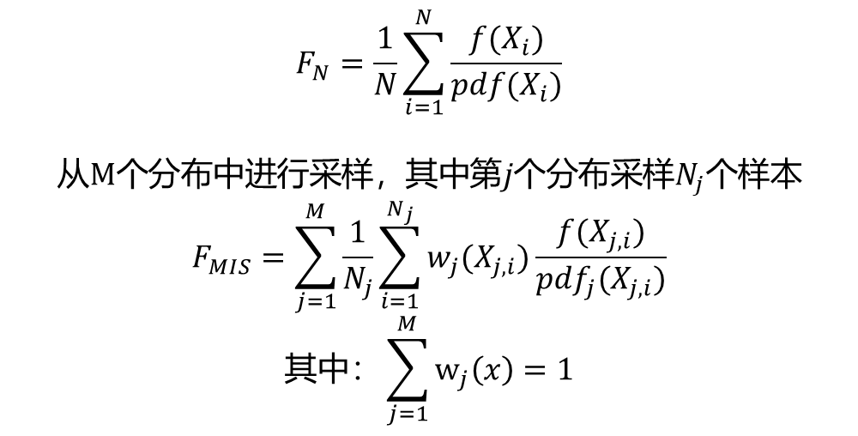
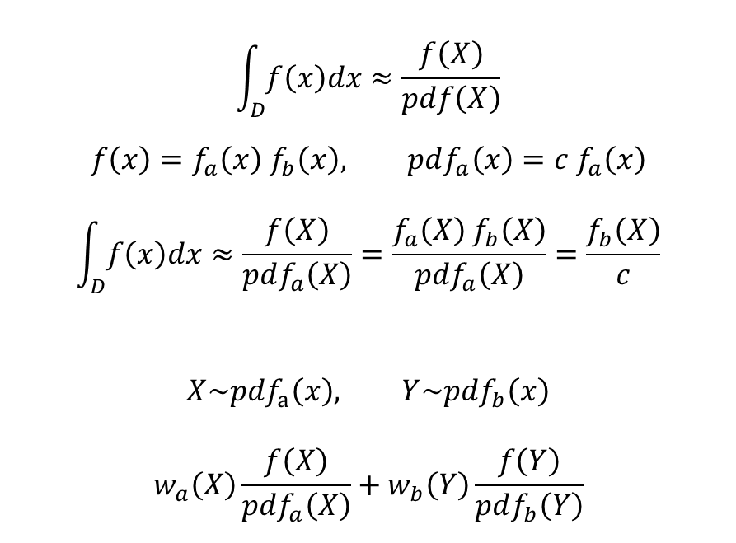
多重重要性采样 Multiple Importance Sampling
$$\int_{D}^{ }{f\left(x\right)dx}≈\frac{f\left(X\right)}{pdf\left(X\right)}$$
$$f\left(x\right)=f_{a}\left(x\right) f_{b}\left(x\right), pdf_{a}\left(x\right)=c f_{a}\left(x\right)$$
$$\int_{D}^{ }{f\left(x\right)dx}≈\frac{f\left(X\right)}{pdf_{a}\left(X\right)}=\frac{f_{a}\left(X\right) f_{b}\left(X\right)}{pdf_{a}\left(X\right)}=\frac{f_{b}\left(X\right)}{c}$$
$$X\sim pdf_{a}\left(x\right), Y\sim pdf_{b}\left(x\right)$$
$$w_{a}\left(X\right)\frac{f\left(X\right)}{pdf_{a}\left(X\right)}+w_{b}\left(Y\right)\frac{f\left(Y\right)}{pdf_{b}\left(Y\right)}$$
$$F_{N}=\frac{1}{N}\sum_{i=1}^{N}{\frac{f(X_{i})}{pdf(X_{i})}}$$
$$从M个分布中进行采样，其中第j个分布采样N_{j}个样本$$
$$F_{MIS}=\sum_{j=1}^{M}{\frac{1}{N_{j}}\sum_{i=1}^{N_{j}}{w_{j}(X_{j, i})\frac{f(X_{j, i})}{{pdf}_{j}(X_{j, i})}}}$$
$$其中：\sum_{j=1}^{M}{w_{j}\left(x\right)}=1$$

Slide 5

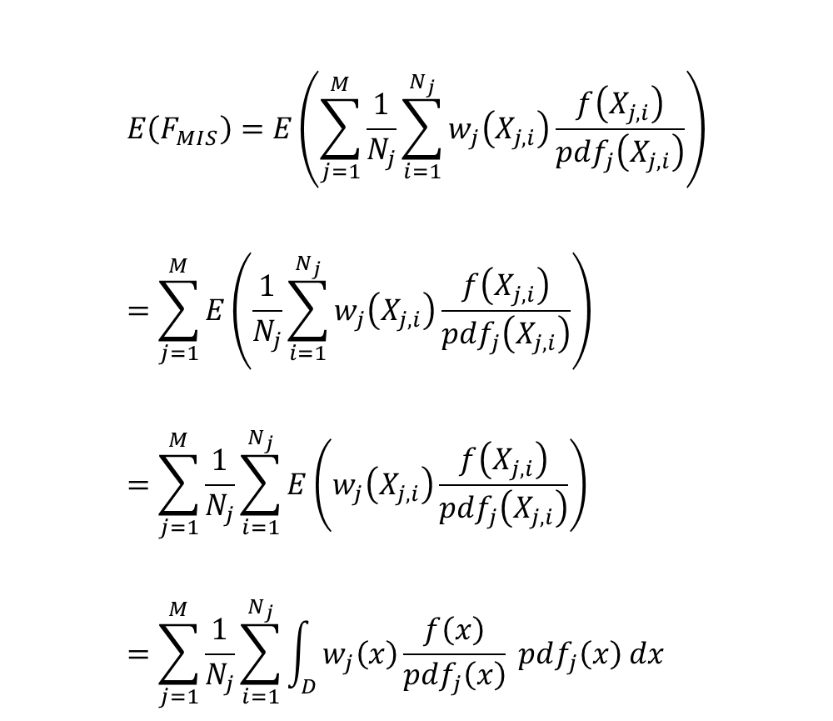
多重重要性采样 Multiple Importance Sampling
$$E\left(F_{MIS}\right)=E\left(\sum_{j=1}^{M}{\frac{1}{N_{j}}\sum_{i=1}^{N_{j}}{w_{j}\left(X_{j, i}\right)\frac{f\left(X_{j, i}\right)}{{pdf}_{j}\left(X_{j, i}\right)}}}\right) \\ =\sum_{j=1}^{M}{E\left(\frac{1}{N_{j}}\sum_{i=1}^{N_{j}}{w_{j}\left(X_{j, i}\right)\frac{f\left(X_{j, i}\right)}{{pdf}_{j}\left(X_{j, i}\right)}}\right)} \\ =\sum_{j=1}^{M}{\frac{1}{N_{j}}\sum_{i=1}^{N_{j}}{E\left(w_{j}\left(X_{j, i}\right)\frac{f\left(X_{j, i}\right)}{{pdf}_{j}\left(X_{j, i}\right)}\right)}} \\ =\sum_{j=1}^{M}{\frac{1}{N_{j}}\sum_{i=1}^{N_{j}}{\int_{D}{w_{j}\left(x\right)\frac{f\left(x\right)}{{pdf}_{j}\left(x\right)} pdf_{j}\left(x\right) dx}}}$$
$$=\sum_{j=1}^{M}{\frac{1}{N_{j}}\sum_{i=1}^{N_{j}}{\int_{D}{w_{j}\left(x\right) f\left(x\right) dx}}} \\ =\sum_{j=1}^{M}{\int_{D}{w_{j}\left(x\right) f\left(x\right) dx}} \\ =\int_{D}{\left(\sum_{j=1}^{M}{w_{j}\left(x\right)}\right)f\left(x\right) dx} \\ =\int_{D}{f\left(x\right) dx}$$

Slide 6

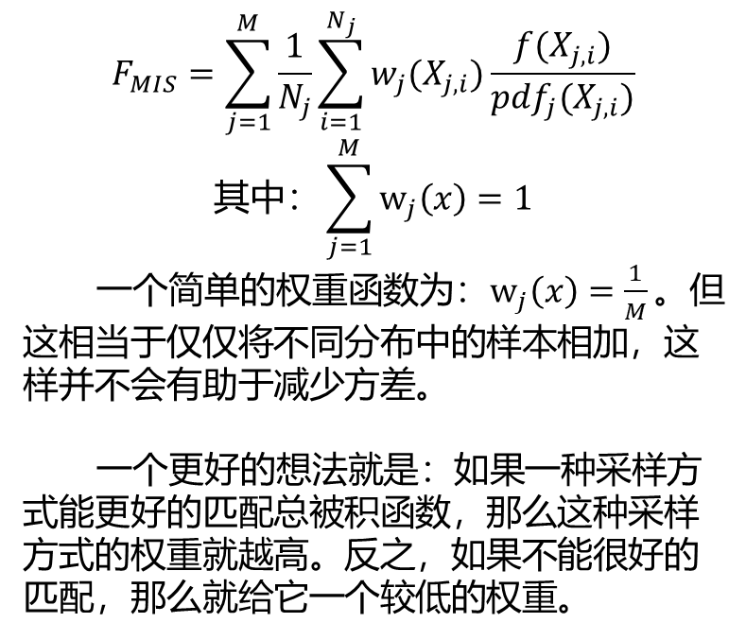

权重函数 Weighting Function
$$F_{MIS}=\sum_{j=1}^{M}{\frac{1}{N_{j}}\sum_{i=1}^{N_{j}}{w_{j}(X_{j, i})\frac{f(X_{j, i})}{{pdf}_{j}(X_{j, i})}}}$$
$$其中：\sum_{j=1}^{M}{w_{j}\left(x\right)}=1$$
一个简单的权重函数为：$w_{j}\left(x\right)=\frac{1}{M}。$但这相当于仅仅将不同分布中的样本相加，这样并不会有助于减少方差。
一个更好的想法就是：如果一种采样方式能更好的匹配总被积函数，那么这种采样方式的权重就越高。反之，如果不能很好的匹配，那么就给它一个较低的权重。
$$\text{平衡启发式}\text{(}\text{Balance} \text{Heuristic})：w_{j}\left(x\right)=\frac{pdf_{j}\left(x\right)}{\sum_{k=1}^{M}{pdf_{k}\left(x\right)}}$$
平衡启发式根据样本的概率密度决定权重函数，样本对应的概率密度越高，它的权重就越大。
$$幂\text{启发式}\text{(}\text{Power} \text{Heuristic})：w_{j}\left(x\right)=\frac{{\left(pdf_{j}\left(x\right)\right)}^{β}}{\sum_{k=1}^{M}{{\left(pdf_{k}\left(x\right)\right)}^{β}}}$$
幂启发式与平衡启发式类似，但是在实践中通常有更好的效果。我们的实现会将令β=2。

Slide 7

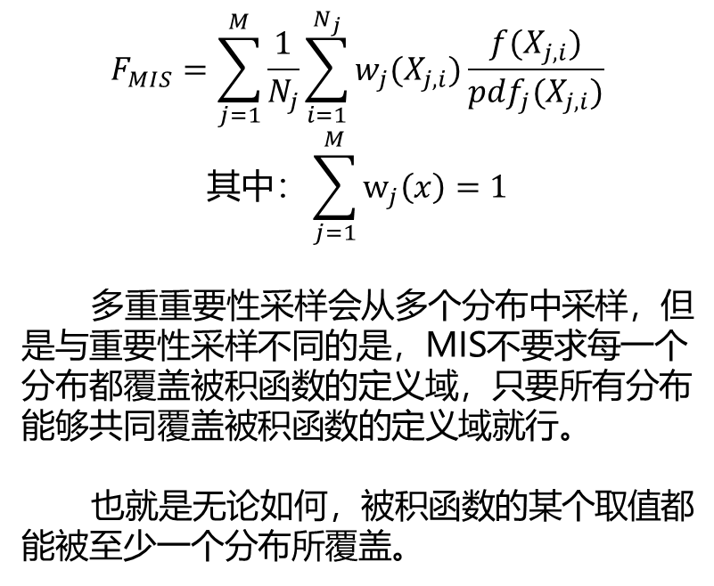
多重重要性采样补偿 MIS Compensation
$$F_{MIS}=\sum_{j=1}^{M}{\frac{1}{N_{j}}\sum_{i=1}^{N_{j}}{w_{j}(X_{j, i})\frac{f(X_{j, i})}{{pdf}_{j}(X_{j, i})}}}$$
$$其中：\sum_{j=1}^{M}{w_{j}\left(x\right)}=1$$
多重重要性采样会从多个分布中采样，但是与重要性采样不同的是，MIS不要求每一个分布都覆盖被积函数的定义域，只要所有分布能够共同覆盖被积函数的定义域就行。
也就是无论如何，被积函数的某个取值都能被至少一个分布所覆盖。
MIS补偿的原理就是锐化一个或多个分布，使得新得到的分布不再包含原分布中概率密度较小的部分，以此来减少方差。
$${pdf}_{j}^{′}\left(x\right)=\frac{\max\left(0, pdf_{j}^{′}\left(x\right)−δ\right)}{\int_{D}{\max\left(0, pdf_{j}^{′}\left(x\right)−δ\right)dx}}$$

Slide 8
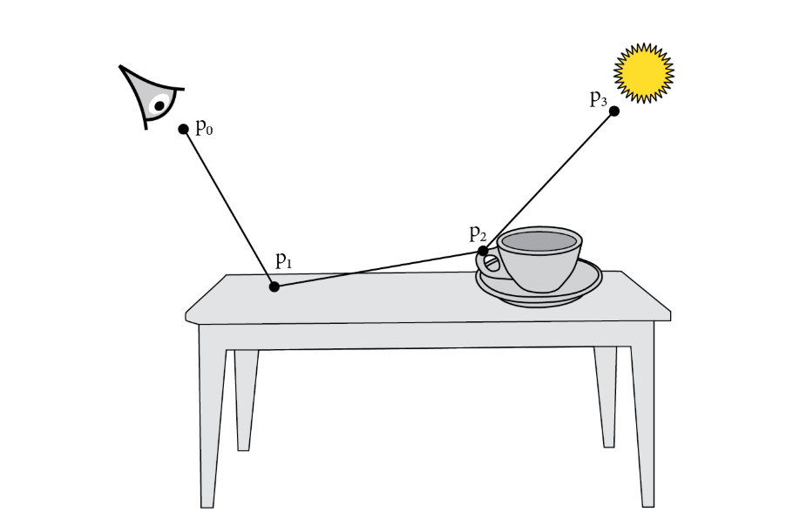

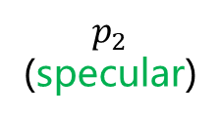

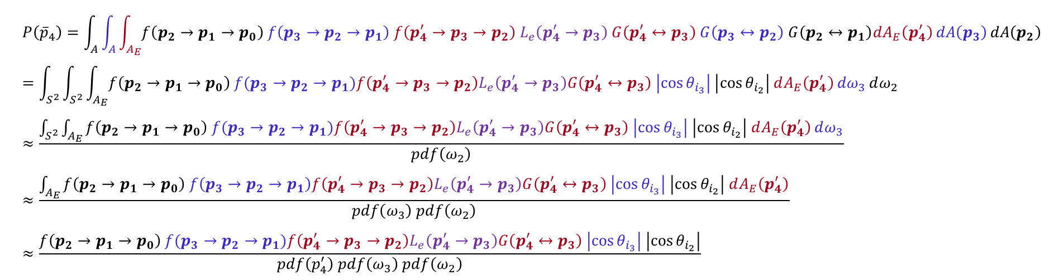
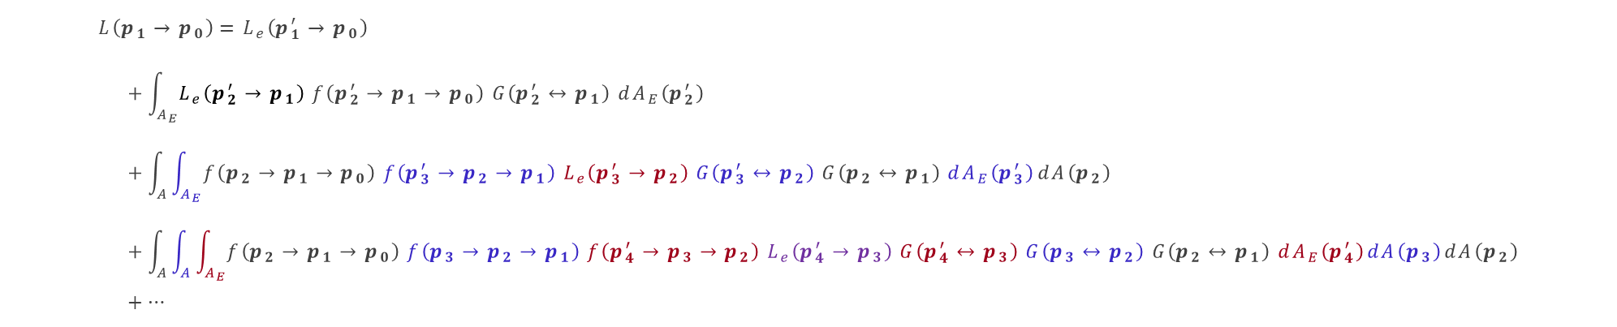












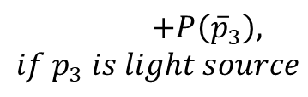







混合两种渲染方程
$$L=P\left({\overline{p}}_{1}\right)+…$$
$$+P\left({\overline{p}}_{2}\right)$$
$$p_{2}^{′}$$
$$p_{0}$$
$$p_{3}^{′}$$
$$+P\left({\overline{p}}_{4}\right)$$
$$p_{1}$$
$$ω_{2}$$
$$p_{4}^{′}$$
$$+P\left({\overline{p}}_{5}\right)$$
$$p_{2}$$
(specular)
$$ω_{3}$$
$$p_{5}^{′}$$
$$p_{3}$$
$$L\left(p_{1}→p_{0}\right)=L_{e}\left(p_{1}^{′}→p_{0}\right) \\ +\int_{A_{E}}{L_{e}\left(p_{2}^{′}→p_{1}\right) f\left(p_{2}^{′}→p_{1}→p_{0}\right) G\left(p_{2}^{′}↔p_{1}\right) dA_{E}\left(p_{2}^{′}\right)} \\ +\int_{A}{\int_{A_{E}}{f\left(p_{2}→p_{1}→p_{0}\right) f\left(p_{3}^{′}→p_{2}→p_{1}\right) L_{e}\left(p_{3}^{′}→p_{2}\right) G\left(p_{3}^{′}↔p_{2}\right) G\left(p_{2}↔p_{1}\right) dA_{E}\left(p_{3}^{′}\right)}dA\left(p_{2}\right)} \\ +\int_{A}{\int_{A}{\int_{A_{E}}{f\left(p_{2}→p_{1}→p_{0}\right) f\left(p_{3}→p_{2}→p_{1}\right) f\left(p_{4}^{′}→p_{3}→p_{2}\right) L_{e}\left(p_{4}^{′}→p_{3}\right) G\left(p_{4}^{′}↔p_{3}\right) G\left(p_{3}↔p_{2}\right) G\left(p_{2}↔p_{1}\right) dA_{E}\left(p_{4}^{′}\right)}dA\left(p_{3}\right)}dA\left(p_{2}\right)} \\ +…$$
=> $P\left({\overline{p}}_{1}\right)$
$$p_{4}$$
$$+P\left({\overline{p}}_{3}\right), if p_{3} is light source$$
$$……$$
$$p_{5}$$
$P\left({\overline{p}}_{2}\right)$ <=
$P\left({\overline{p}}_{3}\right)$ <=
$P\left({\overline{p}}_{4}\right)$ <=
$\sum_{i=5}^{+∞}{P({\overline{p}}_{i})}$<=
$$P\left({\overline{p}}_{4}\right)=\int_{A}{\int_{A}{\int_{A_{E}}{f\left(p_{2}→p_{1}→p_{0}\right) f\left(p_{3}→p_{2}→p_{1}\right) f\left(p_{4}^{′}→p_{3}→p_{2}\right) L_{e}\left(p_{4}^{′}→p_{3}\right) G\left(p_{4}^{′}↔p_{3}\right) G\left(p_{3}↔p_{2}\right) G\left(p_{2}↔p_{1}\right)dA_{E}\left(p_{4}^{′}\right)}dA\left(p_{3}\right)}dA\left(p_{2}\right)} \\ =\int_{S^{2}}{\int_{S^{2}}{\int_{A_{E}}{f\left({p_{2}→p}_{1}→p_{0}\right) f(p_{3}→p_{2}→p_{1})f\left(p_{4}^{′}→p_{3}→p_{2}\right)L_{e}\left(p_{4}^{′}→p_{3}\right)G\left(p_{4}^{′}↔p_{3}\right) \left|\cos{θ_{i_{3}}}\right| \left|\cos{θ_{i_{2}}}\right| dA_{E}\left(p_{4}^{′}\right)}dω_{3}}dω_{2}} \\ ≈\frac{\int_{S^{2}}{\int_{A_{E}}{f\left({p_{2}→p}_{1}→p_{0}\right) f(p_{3}→p_{2}→p_{1})f\left(p_{4}^{′}→p_{3}→p_{2}\right)L_{e}\left(p_{4}^{′}→p_{3}\right)G\left(p_{4}^{′}↔p_{3}\right) \left|\cos{θ_{i_{3}}}\right| \left|\cos{θ_{i_{2}}}\right| dA_{E}\left(p_{4}^{′}\right)}dω_{3}}}{pdf\left(ω_{2}\right)} \\ ≈\frac{\int_{A_{E}}{f\left({p_{2}→p}_{1}→p_{0}\right) f\left(p_{3}→p_{2}→p_{1}\right)f\left(p_{4}^{′}→p_{3}→p_{2}\right)L_{e}\left(p_{4}^{′}→p_{3}\right)G\left(p_{4}^{′}↔p_{3}\right) \left|\cos{θ_{i_{3}}}\right| \left|\cos{θ_{i_{2}}}\right| dA_{E}\left(p_{4}^{′}\right)}}{pdf\left(ω_{3}\right) pdf\left(ω_{2}\right)} \\ ≈\frac{f\left({p_{2}→p}_{1}→p_{0}\right) f(p_{3}→p_{2}→p_{1})f\left(p_{4}^{′}→p_{3}→p_{2}\right)L_{e}\left(p_{4}^{′}→p_{3}\right)G\left(p_{4}^{′}↔p_{3}\right) \left|\cos{θ_{i_{3}}}\right| \left|\cos{θ_{i_{2}}}\right|}{pdf\left(p_{4}^{′}\right) pdf\left(ω_{3}\right) pdf\left(ω_{2}\right)}$$

Slide 9
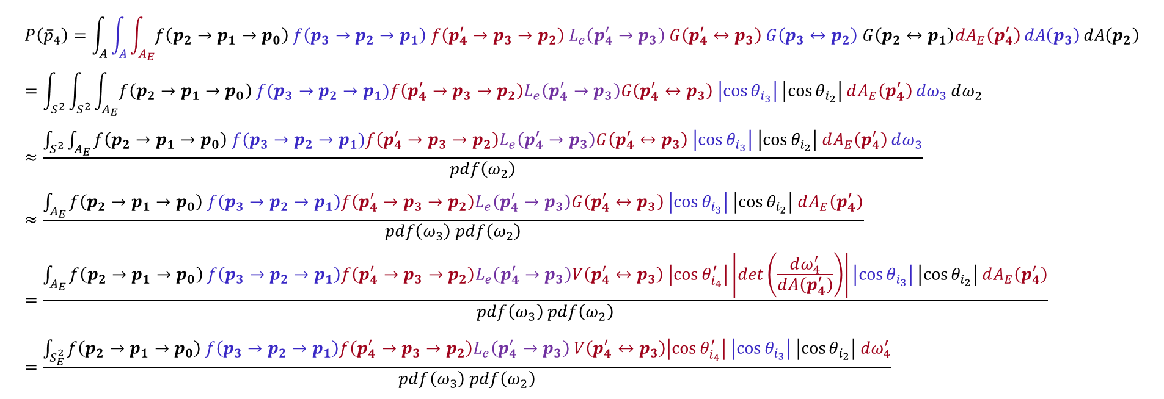


积分域转换
$$L=P\left({\overline{p}}_{1}\right)+…$$
$$+P\left({\overline{p}}_{2}\right)$$
$$p_{2}^{′}$$
$$p_{0}$$
$$ω_{2}^{′}$$
$$ω_{3}^{′}$$
$$p_{3}^{′}$$
$$+P\left({\overline{p}}_{4}\right)$$
$$p_{1}$$
$$ω_{2}$$
$$p_{4}^{′}$$
$$+P\left({\overline{p}}_{5}\right)$$
$$p_{2}$$
(specular)
$$ω_{3}$$
$$p_{5}^{′}$$
$$p_{3}$$
$$p_{4}$$
$$……$$
$$+P\left({\overline{p}}_{3}\right), if p_{3} is light source$$
$$p_{5}$$
$$P\left({\overline{p}}_{4}\right)=\int_{A}{\int_{A}{\int_{A_{E}}{f\left(p_{2}→p_{1}→p_{0}\right) f\left(p_{3}→p_{2}→p_{1}\right) f\left(p_{4}^{′}→p_{3}→p_{2}\right) L_{e}\left(p_{4}^{′}→p_{3}\right) G\left(p_{4}^{′}↔p_{3}\right) G\left(p_{3}↔p_{2}\right) G\left(p_{2}↔p_{1}\right)dA_{E}\left(p_{4}^{′}\right)}dA\left(p_{3}\right)}dA\left(p_{2}\right)} \\ =\int_{S^{2}}{\int_{S^{2}}{\int_{A_{E}}{f\left({p_{2}→p}_{1}→p_{0}\right) f(p_{3}→p_{2}→p_{1})f\left(p_{4}^{′}→p_{3}→p_{2}\right)L_{e}\left(p_{4}^{′}→p_{3}\right)G\left(p_{4}^{′}↔p_{3}\right) \left|\cos{θ_{i_{3}}}\right| \left|\cos{θ_{i_{2}}}\right| dA_{E}\left(p_{4}^{′}\right)}dω_{3}}dω_{2}} \\ ≈\frac{\int_{S^{2}}{\int_{A_{E}}{f\left({p_{2}→p}_{1}→p_{0}\right) f(p_{3}→p_{2}→p_{1})f\left(p_{4}^{′}→p_{3}→p_{2}\right)L_{e}\left(p_{4}^{′}→p_{3}\right)G\left(p_{4}^{′}↔p_{3}\right) \left|\cos{θ_{i_{3}}}\right| \left|\cos{θ_{i_{2}}}\right| dA_{E}\left(p_{4}^{′}\right)}dω_{3}}}{pdf\left(ω_{2}\right)} \\ ≈\frac{\int_{A_{E}}{f\left({p_{2}→p}_{1}→p_{0}\right) f\left(p_{3}→p_{2}→p_{1}\right)f\left(p_{4}^{′}→p_{3}→p_{2}\right)L_{e}\left(p_{4}^{′}→p_{3}\right)G\left(p_{4}^{′}↔p_{3}\right) \left|\cos{θ_{i_{3}}}\right| \left|\cos{θ_{i_{2}}}\right| dA_{E}\left(p_{4}^{′}\right)}}{pdf\left(ω_{3}\right) pdf\left(ω_{2}\right)} \\ =\frac{\int_{A_{E}}{f\left({p_{2}→p}_{1}→p_{0}\right) f\left(p_{3}→p_{2}→p_{1}\right)f\left(p_{4}^{′}→p_{3}→p_{2}\right)L_{e}\left(p_{4}^{′}→p_{3}\right)V\left(p_{4}^{′}↔p_{3}\right) \left|\cos{θ_{i_{4}}^{′}}\right|\left|det\left(\frac{dω_{4}^{′}}{dA\left(p_{4}^{′}\right)}\right)\right|\left|\cos{θ_{i_{3}}}\right| \left|\cos{θ_{i_{2}}}\right| dA_{E}\left(p_{4}^{′}\right)}}{pdf\left(ω_{3}\right) pdf\left(ω_{2}\right)} \\ =\frac{\int_{S_{E}^{2}}{f\left({p_{2}→p}_{1}→p_{0}\right) f\left(p_{3}→p_{2}→p_{1}\right)f\left(p_{4}^{′}→p_{3}→p_{2}\right)L_{e}\left(p_{4}^{′}→p_{3}\right) V\left(p_{4}^{′}↔p_{3}\right)\left|\cos{θ_{i_{4}}^{′}}\right| \left|\cos{θ_{i_{3}}}\right| \left|\cos{θ_{i_{2}}}\right| dω_{4}^{′}}}{pdf\left(ω_{3}\right) pdf\left(ω_{2}\right)}$$

Slide 10
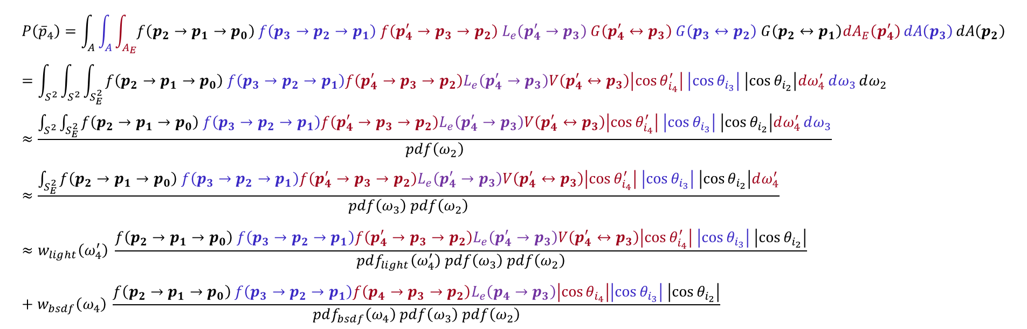
应用多重重要性采样
$$L=P\left({\overline{p}}_{1}\right)+…$$
$$+P\left({\overline{p}}_{2}\right)$$
$$p_{2}^{′}$$
$$p_{0}$$
$$ω_{2}^{′}$$
$$ω_{3}^{′}$$
$$p_{3}^{′}$$
$$+P\left({\overline{p}}_{4}\right)$$
$$p_{1}$$
$$ω_{2}$$
$$p_{4}^{′}$$
$$+P\left({\overline{p}}_{5}\right)$$
$$p_{2}$$
(specular)
$$ω_{3}$$
$$p_{5}^{′}$$
$$p_{3}$$
$$p_{4}$$
$$……$$
$$+P\left({\overline{p}}_{3}\right), if p_{3} is light source$$
$$p_{5}$$
$$P\left({\overline{p}}_{4}\right)=\int_{A}{\int_{A}{\int_{A_{E}}{f\left(p_{2}→p_{1}→p_{0}\right) f\left(p_{3}→p_{2}→p_{1}\right) f\left(p_{4}^{′}→p_{3}→p_{2}\right) L_{e}\left(p_{4}^{′}→p_{3}\right) G\left(p_{4}^{′}↔p_{3}\right) G\left(p_{3}↔p_{2}\right) G\left(p_{2}↔p_{1}\right)dA_{E}\left(p_{4}^{′}\right)}dA\left(p_{3}\right)}dA\left(p_{2}\right)} \\ =\int_{S^{2}}{\int_{S^{2}}{\int_{S_{E}^{2}}{f\left({p_{2}→p}_{1}→p_{0}\right) f\left(p_{3}→p_{2}→p_{1}\right)f\left(p_{4}^{′}→p_{3}→p_{2}\right)L_{e}\left(p_{4}^{′}→p_{3}\right)V\left(p_{4}^{′}↔p_{3}\right)\left|\cos{θ_{i_{4}}^{′}}\right| \left|\cos{θ_{i_{3}}}\right| \left|\cos{θ_{i_{2}}}\right|dω_{4}^{′}}dω_{3}}dω_{2}} \\ ≈\frac{\int_{S^{2}}{\int_{S_{E}^{2}}{f\left({p_{2}→p}_{1}→p_{0}\right) f\left(p_{3}→p_{2}→p_{1}\right)f\left(p_{4}^{′}→p_{3}→p_{2}\right)L_{e}\left(p_{4}^{′}→p_{3}\right)V\left(p_{4}^{′}↔p_{3}\right)\left|\cos{θ_{i_{4}}^{′}}\right| \left|\cos{θ_{i_{3}}}\right| \left|\cos{θ_{i_{2}}}\right|dω_{4}^{′}}dω_{3}}}{pdf\left(ω_{2}\right)} \\ ≈\frac{\int_{S_{E}^{2}}{f\left({p_{2}→p}_{1}→p_{0}\right) f\left(p_{3}→p_{2}→p_{1}\right)f\left(p_{4}^{′}→p_{3}→p_{2}\right)L_{e}\left(p_{4}^{′}→p_{3}\right)V\left(p_{4}^{′}↔p_{3}\right)\left|\cos{θ_{i_{4}}^{′}}\right| \left|\cos{θ_{i_{3}}}\right| \left|\cos{θ_{i_{2}}}\right|dω_{4}^{′}}}{pdf\left(ω_{3}\right) pdf\left(ω_{2}\right)} \\ ≈w_{light}\left(ω_{4}^{′}\right) \frac{f\left({p_{2}→p}_{1}→p_{0}\right) f\left(p_{3}→p_{2}→p_{1}\right)f\left(p_{4}^{′}→p_{3}→p_{2}\right)L_{e}\left(p_{4}^{′}→p_{3}\right)V\left(p_{4}^{′}↔p_{3}\right)\left|\cos{θ_{i_{4}}^{′}}\right| \left|\cos{θ_{i_{3}}}\right| \left|\cos{θ_{i_{2}}}\right|}{pdf_{light}\left(ω_{4}^{′}\right) pdf\left(ω_{3}\right) pdf\left(ω_{2}\right)}+w_{bsdf}\left(ω_{4}\right) \frac{f\left({p_{2}→p}_{1}→p_{0}\right) f\left(p_{3}→p_{2}→p_{1}\right)f\left(p_{4}→p_{3}→p_{2}\right)L_{e}\left(p_{4}→p_{3}\right)\left|\cos{θ_{i_{4}}}\right|\left|\cos{θ_{i_{3}}}\right| \left|\cos{θ_{i_{2}}}\right|}{pdf_{bsdf}\left(ω_{4}\right) pdf\left(ω_{3}\right) pdf\left(ω_{2}\right)}$$

Slide 11
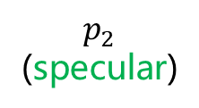

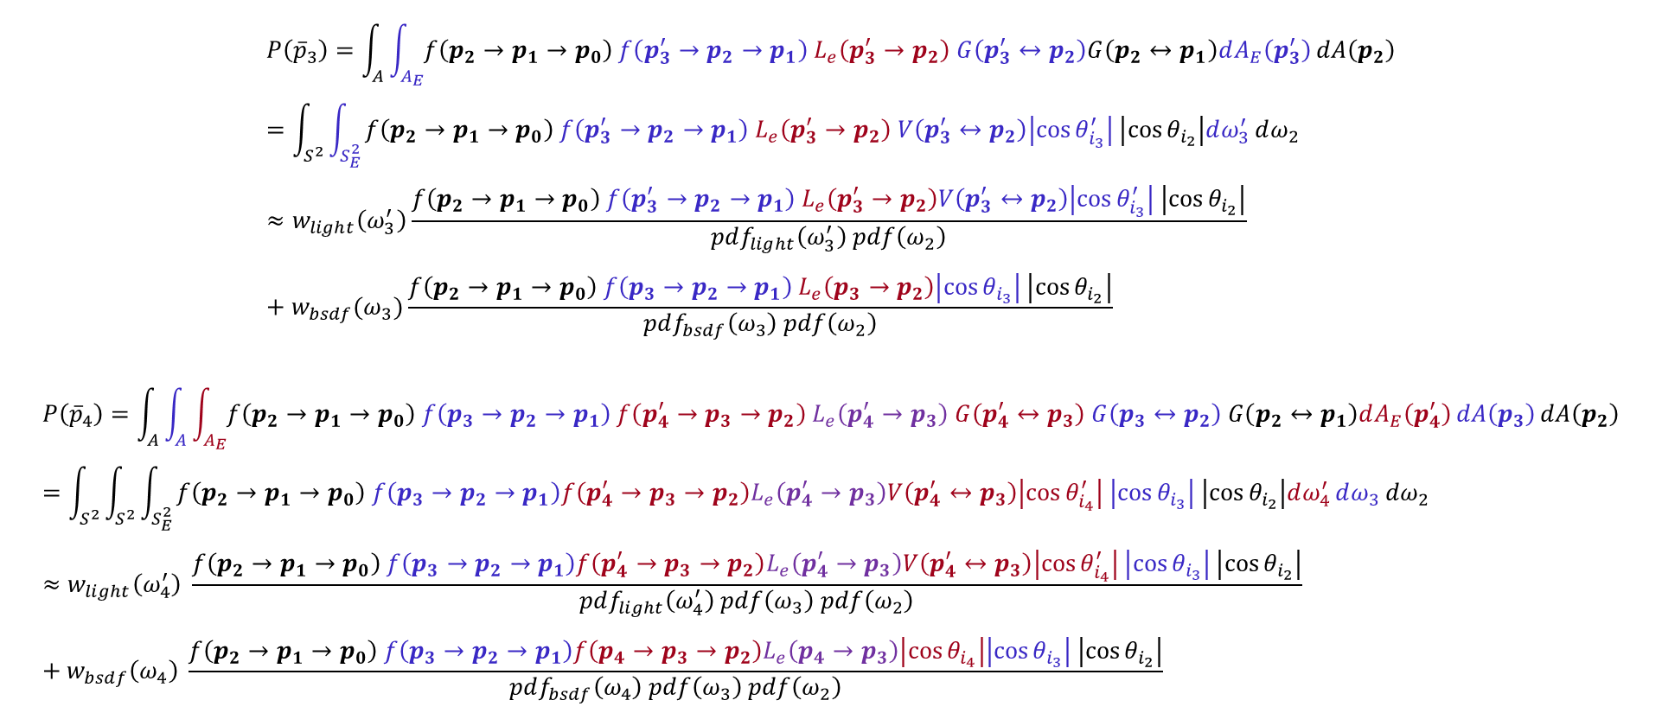

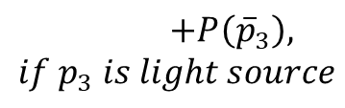


应用多重重要性采样
$$L=P\left({\overline{p}}_{1}\right)+…$$
$$+P\left({\overline{p}}_{2}\right)$$
$$p_{0}$$
$$ω_{2}^{′}$$
$$p_{2}^{′}$$
$$ω_{3}^{′}$$
$$p_{3}^{′}$$
$$+P\left({\overline{p}}_{4}\right)$$
$$p_{1}$$
$$ω_{2}$$
$$p_{4}^{′}$$
$$+P\left({\overline{p}}_{5}\right)$$
$$p_{2}$$
(specular)
$$ω_{3}$$
$$p_{5}^{′}$$
$$p_{3}$$
$$p_{4}$$
$$……$$
$$+P\left({\overline{p}}_{3}\right), if p_{3} is light source$$
$$p_{5}$$
$$P\left({\overline{p}}_{3}\right)=\int_{A}{\int_{A_{E}}{f\left(p_{2}→p_{1}→p_{0}\right) f\left(p_{3}^{′}→p_{2}→p_{1}\right) L_{e}\left(p_{3}^{′}→p_{2}\right) G\left(p_{3}^{′}↔p_{2}\right)G\left(p_{2}↔p_{1}\right)dA_{E}\left(p_{3}^{′}\right)}dA\left(p_{2}\right)} \\ =\int_{S^{2}}{\int_{S_{E}^{2}}{f\left(p_{2}→p_{1}→p_{0}\right) f\left(p_{3}^{′}→p_{2}→p_{1}\right) L_{e}\left(p_{3}^{′}→p_{2}\right) V\left(p_{3}^{′}↔p_{2}\right)\left|\cos{θ_{i_{3}}^{′}}\right| \left|\cos{θ_{i_{2}}}\right|dω_{3}^{′}}dω_{2}} \\ ≈w_{light}\left(ω_{3}^{′}\right)\frac{f\left(p_{2}→p_{1}→p_{0}\right) f\left(p_{3}^{′}→p_{2}→p_{1}\right) L_{e}\left(p_{3}^{′}→p_{2}\right)V\left(p_{3}^{′}↔p_{2}\right)\left|\cos{θ_{i_{3}}^{′}}\right| \left|\cos{θ_{i_{2}}}\right|}{pdf_{light}\left(ω_{3}^{′}\right) pdf\left(ω_{2}\right)}+w_{bsdf}(ω_{3})\frac{f\left(p_{2}→p_{1}→p_{0}\right) f\left(p_{3}→p_{2}→p_{1}\right) L_{e}\left(p_{3}→p_{2}\right)\left|\cos{θ_{i_{3}}}\right| \left|\cos{θ_{i_{2}}}\right|}{pdf_{bsdf}\left(ω_{3}\right) pdf\left(ω_{2}\right)}$$
$$P\left({\overline{p}}_{4}\right)=\int_{A}{\int_{A}{\int_{A_{E}}{f\left(p_{2}→p_{1}→p_{0}\right) f\left(p_{3}→p_{2}→p_{1}\right) f\left(p_{4}^{′}→p_{3}→p_{2}\right) L_{e}\left(p_{4}^{′}→p_{3}\right) G\left(p_{4}^{′}↔p_{3}\right) G\left(p_{3}↔p_{2}\right) G\left(p_{2}↔p_{1}\right)dA_{E}\left(p_{4}^{′}\right)}dA\left(p_{3}\right)}dA\left(p_{2}\right)} \\ =\int_{S^{2}}{\int_{S^{2}}{\int_{S_{E}^{2}}{f\left({p_{2}→p}_{1}→p_{0}\right) f\left(p_{3}→p_{2}→p_{1}\right)f\left(p_{4}^{′}→p_{3}→p_{2}\right)L_{e}\left(p_{4}^{′}→p_{3}\right)V\left(p_{4}^{′}↔p_{3}\right)\left|\cos{θ_{i_{4}}^{′}}\right| \left|\cos{θ_{i_{3}}}\right| \left|\cos{θ_{i_{2}}}\right|dω_{4}^{′}}dω_{3}}dω_{2}} \\ ≈w_{light}\left(ω_{4}^{′}\right) \frac{f\left({p_{2}→p}_{1}→p_{0}\right) f\left(p_{3}→p_{2}→p_{1}\right)f\left(p_{4}^{′}→p_{3}→p_{2}\right)L_{e}\left(p_{4}^{′}→p_{3}\right)V\left(p_{4}^{′}↔p_{3}\right)\left|\cos{θ_{i_{4}}^{′}}\right| \left|\cos{θ_{i_{3}}}\right| \left|\cos{θ_{i_{2}}}\right|}{pdf_{light}\left(ω_{4}^{′}\right) pdf\left(ω_{3}\right) pdf\left(ω_{2}\right)}+w_{bsdf}\left(ω_{4}\right) \frac{f\left({p_{2}→p}_{1}→p_{0}\right) f\left(p_{3}→p_{2}→p_{1}\right)f\left(p_{4}→p_{3}→p_{2}\right)L_{e}\left(p_{4}→p_{3}\right)\left|\cos{θ_{i_{4}}}\right|\left|\cos{θ_{i_{3}}}\right| \left|\cos{θ_{i_{2}}}\right|}{pdf_{bsdf}\left(ω_{4}\right) pdf\left(ω_{3}\right) pdf\left(ω_{2}\right)}$$

Slide 12
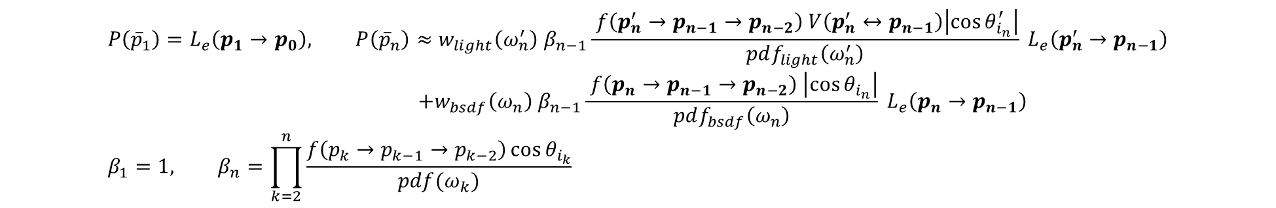
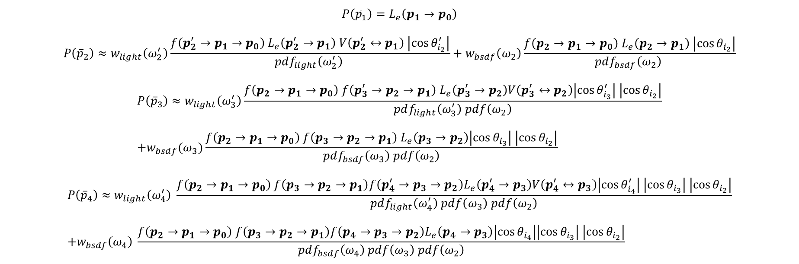
应用多重重要性采样
$$P\left({\overline{p}}_{1}\right)=L_{e}\left(p_{1}→p_{0}\right)$$
$$P\left({\overline{p}}_{2}\right)≈w_{light}\left(ω_{2}^{′}\right)\frac{f\left(p_{2}^{′}→p_{1}→p_{0}\right) L_{e}\left(p_{2}^{′}→p_{1}\right) V\left(p_{2}^{′}↔p_{1}\right) \left|\cos{θ_{i_{2}}^{′}}\right|}{pdf_{light}\left(ω_{2}^{′}\right) }+w_{bsdf}\left(ω_{2}\right)\frac{f\left(p_{2}→p_{1}→p_{0}\right) L_{e}\left(p_{2}→p_{1}\right) \left|\cos{θ_{i_{2}}}\right|}{pdf_{bsdf}\left(ω_{2}\right) }$$
$$P\left({\overline{p}}_{3}\right)≈w_{light}\left(ω_{3}^{′}\right)\frac{f\left(p_{2}→p_{1}→p_{0}\right) f\left(p_{3}^{′}→p_{2}→p_{1}\right) L_{e}\left(p_{3}^{′}→p_{2}\right)V\left(p_{3}^{′}↔p_{2}\right)\left|\cos{θ_{i_{3}}^{′}}\right| \left|\cos{θ_{i_{2}}}\right|}{pdf_{light}\left(ω_{3}^{′}\right) pdf\left(ω_{2}\right)} \\ +w_{bsdf}(ω_{3})\frac{f\left(p_{2}→p_{1}→p_{0}\right) f\left(p_{3}→p_{2}→p_{1}\right) L_{e}\left(p_{3}→p_{2}\right)\left|\cos{θ_{i_{3}}}\right| \left|\cos{θ_{i_{2}}}\right|}{pdf_{bsdf}\left(ω_{3}\right) pdf\left(ω_{2}\right)}$$
$$P\left({\overline{p}}_{4}\right)≈w_{light}\left(ω_{4}^{′}\right) \frac{f\left({p_{2}→p}_{1}→p_{0}\right) f\left(p_{3}→p_{2}→p_{1}\right)f\left(p_{4}^{′}→p_{3}→p_{2}\right)L_{e}\left(p_{4}^{′}→p_{3}\right)V\left(p_{4}^{′}↔p_{3}\right)\left|\cos{θ_{i_{4}}^{′}}\right| \left|\cos{θ_{i_{3}}}\right| \left|\cos{θ_{i_{2}}}\right|}{pdf_{light}\left(ω_{4}^{′}\right) pdf\left(ω_{3}\right) pdf\left(ω_{2}\right)} \\ +w_{bsdf}\left(ω_{4}\right) \frac{f\left({p_{2}→p}_{1}→p_{0}\right) f\left(p_{3}→p_{2}→p_{1}\right)f\left(p_{4}→p_{3}→p_{2}\right)L_{e}\left(p_{4}→p_{3}\right)\left|\cos{θ_{i_{4}}}\right|\left|\cos{θ_{i_{3}}}\right| \left|\cos{θ_{i_{2}}}\right|}{pdf_{bsdf}\left(ω_{4}\right) pdf\left(ω_{3}\right) pdf\left(ω_{2}\right)}$$
$$P\left({\overline{p}}_{1}\right)=L_{e}\left(p_{1}→p_{0}\right), P\left({\overline{p}}_{n}\right)≈w_{light}\left(ω_{n}^{′}\right) β_{n−1}\frac{ f\left(p_{n}^{′}→p_{n−1}→p_{n−2}\right) V\left(p_{n}^{′}↔p_{n−1}\right)\left|\cos{θ_{i_{n}}^{′}}\right|}{pdf_{light}\left(ω_{n}^{′}\right)} L_{e}\left(p_{n}^{′}→p_{n−1}\right) \\ +w_{bsdf}\left(ω_{n}\right) β_{n−1}\frac{ f\left(p_{n}→p_{n−1}→p_{n−2}\right) \left|\cos{θ_{i_{n}}}\right|}{pdf_{bsdf}\left(ω_{n}\right)} L_{e}\left(p_{n}→p_{n−1}\right) \\ β_{1}=1, β_{n}=\prod_{k=2}^{n}{\frac{f\left(p_{k}→p_{k−1}→p_{k−2}\right)\cos{θ_{i_{k}}}}{pdf(ω_{k})}}$$

Slide 13

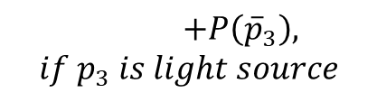
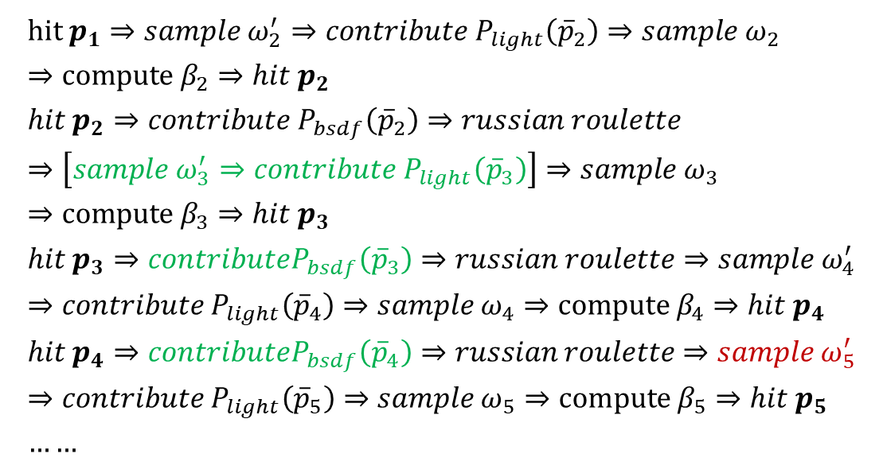







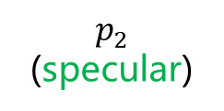

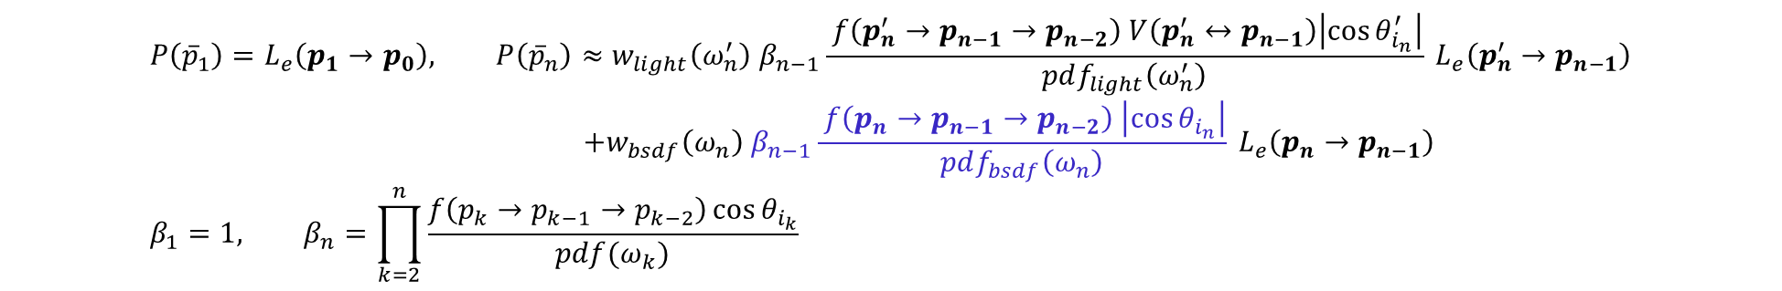














路径追踪流程
$$P\left({\overline{p}}_{1}\right)=L_{e}\left(p_{1}→p_{0}\right), P\left({\overline{p}}_{n}\right)≈w_{light}\left(ω_{n}^{′}\right) β_{n−1}\frac{ f\left(p_{n}^{′}→p_{n−1}→p_{n−2}\right) V\left(p_{n}^{′}↔p_{n−1}\right)\left|\cos{θ_{i_{n}}^{′}}\right|}{pdf_{light}\left(ω_{n}^{′}\right)} L_{e}\left(p_{n}^{′}→p_{n−1}\right) \\ +w_{bsdf}\left(ω_{n}\right) β_{n−1}\frac{ f\left(p_{n}→p_{n−1}→p_{n−2}\right) \left|\cos{θ_{i_{n}}}\right|}{pdf_{bsdf}\left(ω_{n}\right)} L_{e}\left(p_{n}→p_{n−1}\right) \\ β_{1}=1, β_{n}=\prod_{k=2}^{n}{\frac{f\left(p_{k}→p_{k−1}→p_{k−2}\right)\cos{θ_{i_{k}}}}{pdf(ω_{k})}}$$
$$β_{n}$$
$$L=P\left({\overline{p}}_{1}\right)+…$$
$$+P\left({\overline{p}}_{2}\right)$$
$$hit p_{1}⇒sample ω_{2}^{′}⇒contribute P_{light}\left({\overline{p}}_{2}\right)⇒sample ω_{2}⇒compute β_{2}⇒hit p_{2} \\ hit p_{2}⇒contribute P_{bsdf}\left({\overline{p}}_{2}\right)⇒russian roulette⇒\left[sample ω_{3}^{′}⇒contribute P_{light}\left({\overline{p}}_{3}\right)\right]⇒sample ω_{3}⇒compute β_{3}⇒hit p_{3} \\ hit p_{3}⇒contributeP_{bsdf}\left({\overline{p}}_{3}\right)⇒russian roulette⇒sample ω_{4}^{′}⇒contribute P_{light}\left({\overline{p}}_{4}\right)⇒sample ω_{4}⇒compute β_{4}⇒hit p_{4} \\ hit p_{4}⇒contributeP_{bsdf}\left({\overline{p}}_{4}\right)⇒russian roulette⇒sample ω_{5}^{′}⇒contribute P_{light}\left({\overline{p}}_{5}\right)⇒sample ω_{5}⇒compute β_{5}⇒hit p_{5} \\ ……$$
$$p_{2}^{′}$$
$$p_{0}$$
$$ω_{2}^{′}$$
$$p_{3}^{′}$$
$$+P\left({\overline{p}}_{4}\right)$$
$$p_{1}$$
$$ω_{2}$$
$$ω_{3}^{′}$$
$$p_{4}^{′}$$
$$+P\left({\overline{p}}_{5}\right)$$
$$p_{2}$$
(specular)
$$ω_{4}^{′}$$
$$ω_{3}$$
$$p_{5}^{′}$$
$$p_{3}$$
$$ω_{5}^{′}$$
$$ω_{4}$$
$$p_{4}$$
$$ω_{5}$$
$$……$$
$$+P\left({\overline{p}}_{3}\right), if p_{3} is light source$$
$$p_{5}$$

Slide 14
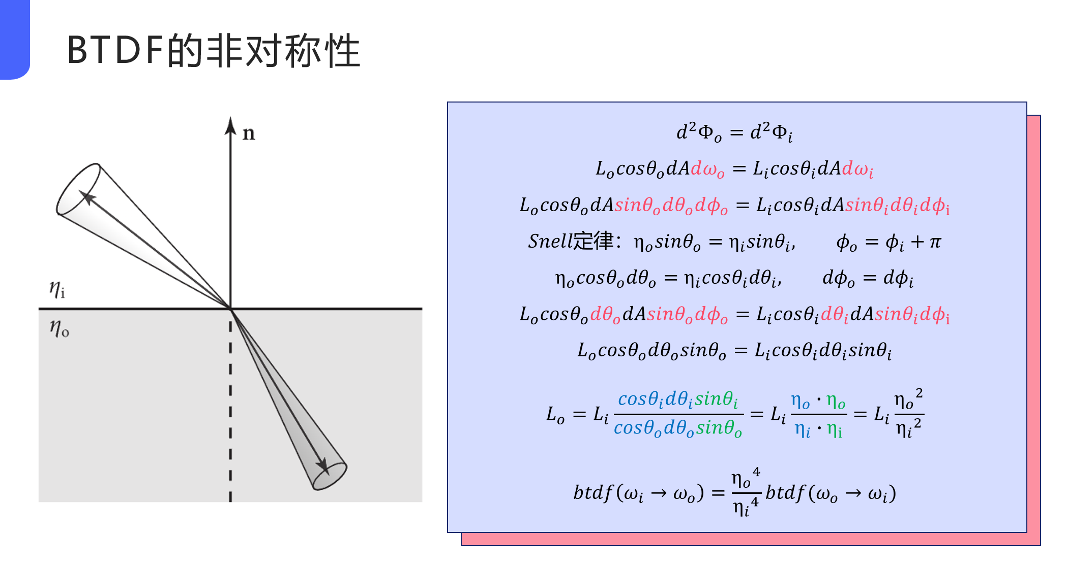
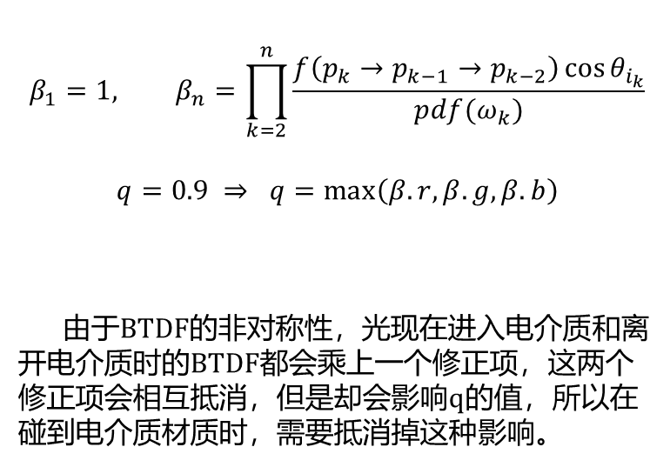
更好的俄罗斯轮盘赌
$$β_{1}=1, β_{n}=\prod_{k=2}^{n}{\frac{f\left(p_{k}→p_{k−1}→p_{k−2}\right)\cos{θ_{i_{k}}}}{pdf(ω_{k})}}$$
$$q=0.9 ⇒ q=\max\left(β.r,β.g,β.b\right)$$
由于BTDF的非对称性，光现在进入电介质和离开电介质时的BTDF都会乘上一个修正项，这两个修正项会相互抵消，但是却会影响q的值，所以在碰到电介质材质时，需要抵消掉这种影响。

